Slide 1
Java Server Pages

Slide 2
JSP
It stands for Java Server Pages.
It is a server side technology.
It is used for creating web application.
It is used to create dynamic web content.
In this JSP tags are used to insert JAVA code into HTML pages.
It is an advanced version of Servlet Technology.
It is a Web based technology helps us to create dynamic and platform independent web pages.
JSP is first converted into servlet by JSP container before processing the client’s request.

Slide 3
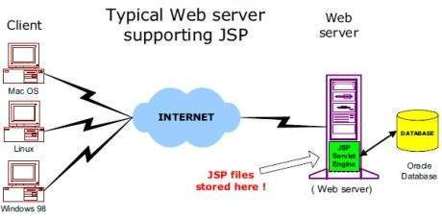
JSP Architecture:
The web server needs a JSP engine, i.e, a container to process JSP pages. The JSP container is responsible for intercepting requests for JSP pages.
A JSP container works with the Web server to provide the runtime environment and other services a JSP needs. It knows how to understand the special elements that are part of JSPs.

Slide 4
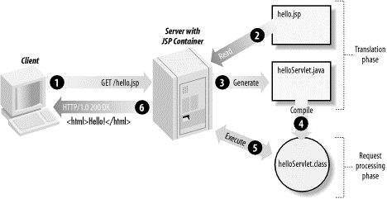
JSP Processing

Slide 5
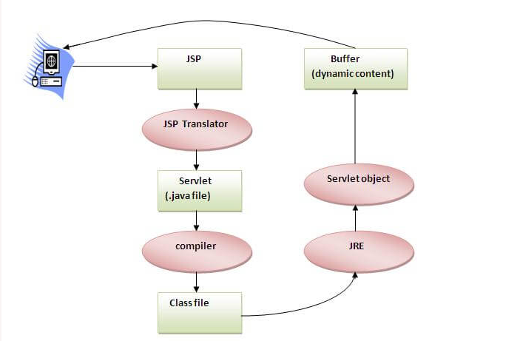
Lifecycle of a JSP:
Translation of JSP Page
Compilation of JSP Page
Classloading (the classloader loads class file)
Instantiation (Object of the Generated Servlet is created).
Initialization ( the container invokes jspInit() method).
Request processing ( the container invokes _jspService() method).
Destroy ( the container invokes jspDestroy() method)

Slide 6
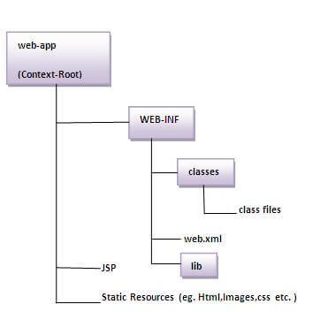

Slide 7
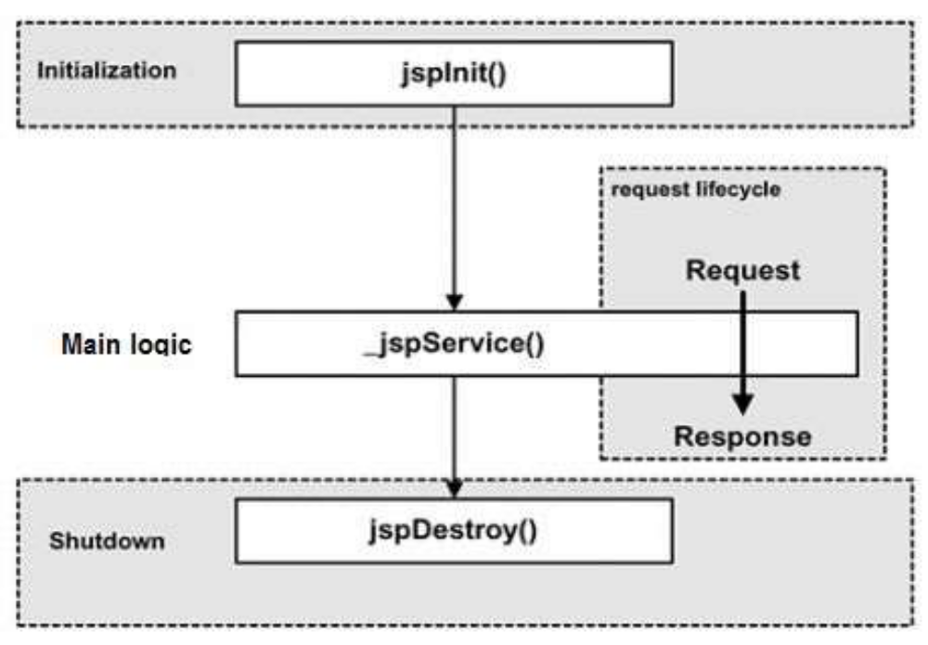
Life cycle methods of JSP
  jspInit( )
  _jspService( )
  jspDestroy( )

Slide 8
jspInit() method:
  public void jspInit()
  {
  // Initialization code
  }
The _jspService() method takes an HttpServletRequest and an HttpServletResponse as its parameters
  public void _jspService(HttpServletRequest request, HttpServletResponse response) {
  //Service handling code
  }
The jspDestroy() method has the following form −
  public void jspDestroy() {
  // Your cleanup code goes here.
  }

Slide 9
Creating a simple JSP Page
index.jsp
<html>
<body>
<% out.print(2*5); %>
</body>
</html>
How to run a simple JSP Page?
http://localhost:8080/myapplication/index.jsp

Slide 10
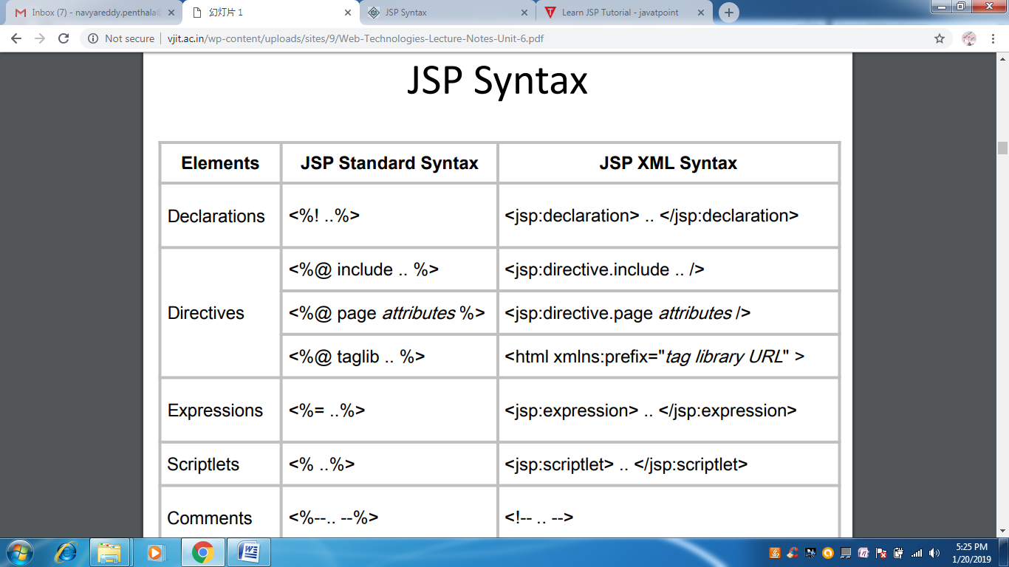
Anatomy of a JSP Page
Besides HTML tag elements, anatomy of JSP provides four basic categories of constructors (markup tags): directives, scripting elements, standard actions, and comments.
  JSP Scripting Elements
  JSP Directives
  JSP Actions
  JSP comments
  Expression Language

Slide 11
JSP scripting elements
The scripting elements provide the ability to insert java code inside the jsp. There are three types of scripting elements:
  scriptlet tag
  expression tag
  declaration tag
1. JSP scriptlet tag: A scriptlet tag is used to execute java source code in JSP.
Syntax :
<% java source code %>
Example:
<html>
<body>
<% out.print("welcome to jsp"); %>
</body>
</html>

Slide 12
Example of JSP scriptlet tag that prints the user name
File: index.html
<html><body>
<form action="welcome.jsp">
<input type="text" name="uname">
<input type="submit" value="go"><br/>
</form> </body> </html>
File: welcome.jsp
<html><body>
<form>
<%
String name=request.getParameter("uname");
out.print("welcome "+name);
%>
</form>
</body> </html>

Slide 13
JSP expression tag:
The code placed within JSP expression tag is written to the output stream of the response. It is mainly used to print the values of variable or method.
Syntax : <%= statement %>
Example :
<html><body>
<%= "welcome to jsp" %>
</body></html>
Example of JSP expression tag that prints the user name
File: index.jsp
<html> <body>
<form action="welcome.jsp">
<input type="text" name="uname"><br/>
<input type="submit" value="go">
</form> </body> </html>
File: welcome.jsp
<html><body>
<%= "Welcome "+request.getParameter("uname") %>
</body> </html>

Slide 14
JSP Declaration Tag: The JSP declaration tag is used to declare fields and methods.
Syntax :
<%! field or method declaration %>
Jsp Scriptlet Tag | Jsp Declaration Tag
The jsp scriptlet tag can only declare variables not methods. | The jsp declaration tag can declare variables as well as methods.
The declaration of scriptlet tag is placed inside the _jspService() method. | The declaration of jsp declaration tag is placed outside the _jspService() method.

Slide 15
Example of JSP declaration tag that declares field
index.jsp
<html>
<body>
<%! int data=50; %>
<%= "Value of the variable is:"+data %>
</body>
</html>

Slide 16
JSP Directives
JSP directives provide directions and instructions to the container, telling it how to handle certain aspects of JSP processing. A JSP directive affects the overall structure of the servlet class
Syntax:
<%@ directive attribute = "value" %>
Directive | Description
<%@ page ... %> | Defines page-dependent attributes, such as scripting language, error page, and buffering requirements.
<%@ include ... %> | Includes a file during the translation phase.
<%@taglib.... %> | Declares a tag library, containing custom actions, used in the page

Slide 17
JSP Actions: There are many JSP action tags or elements.
Syntax:
<jsp:action_name attribute=”value”/>
JSP Action Tags | Description
jsp:forward | forwards the request and response to another resource.
jsp:include | includes another resource.
jsp:useBean | creates or locates bean object.
jsp:setProperty | sets the value of property in bean object.
jsp:getProperty | prints the value of property of the bean.
jsp:plugin | embeds another components such as applet.
jsp:param | sets the parameter value. It is used in forward and include mostly.
jsp:fallback | can be used to print the message if plugin is working. It is used in jsp:plugin.

Slide 18
JSP comments: JSP comments are used for documenting JSP code and are not visible client-side (using browser's View Source option) where as HTML comments are visible.
Syntax: <! ------------- Comments-------------------!>
Expression Language
EL uses a shorthand notation of ${ expr } instead of <%=expr %>.

Slide 19
<html><body>
<%@page import="java.util.Date"%>
<%!
Date date;
%>
<%
date = new Date( );
%>
<b>System date and time: </b> <%= date %>
</body></html>

Slide 20
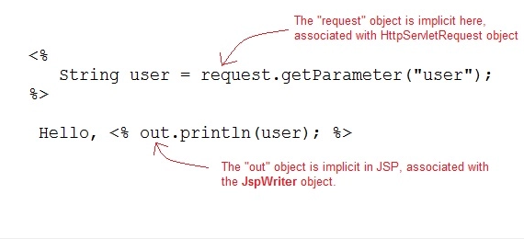
Implicit Objects
JSP provide access to some implicit object which represent some commonly used objects for servlets that JSP page developers might need to use. For example you can retrieve HTML form parameter data by using request variable, which represent the HttpServletRequest object.

Slide 21
Implicit Object | Description
Request | The HttpServletRequest object associated with the request.
response | The HttpServletRequest object associated with the response that is sent back to the browser.
Out | The JspWriter object associated with the output stream of the response.
Session | The HttpSession object associated with the session for the given user of request.
application | The ServletContext object for the web application.
Config | The ServletConfig object associated with the servlet for current JSP page.
pageContext | The PageContext object that encapsulates the enviroment of a single request for this current JSP page
Page | The page variable is equivalent to this variable of Java programming language.
exception | The exception object represents the Throwable object that was thrown by some other JSP page.

Slide 22
Example: // JSP to count the total number of hits on a particular page
<%@ page import = "java.io.*,java.util.*" %>
<html>
<head><title>Application object in JSP</title></head>
<body>
<%
Integer hitsCount = (Integer)application.getAttribute("hitCounter");
if( hitsCount ==null || hitsCount == 0 ) {
out.println("Welcome to my website!");
hitsCount = 1;
} else {
out.println("Welcome back to my website!");
hitsCount += 1;
}
application.setAttribute("hitCounter", hitsCount);
%>
<center>
<p>Total number of visits: <%= hitsCount%></p>
</center></body></html>

Slide 23
Control Structures
if…else
<%! int day = 3; %>
<html>
<head><title>IF...ELSE Example</title></head>
<body>
<% if (day == 1 | day == 7) { %>
<p> Today is weekend</p>
<% } else { %>
<p> Today is not weekend</p>
<% } %>
</body>
</html>

Slide 24
switch...case
<%! int day = 3; %>
<html> <head><title>SWITCH...CASE Example</title></head>
<body>
<% switch(day)
{
case 0: out.println("It\'s Sunday.");
break;
case 1: out.println("It\'s Monday.");
break;
case 2: out.println("It\'s Tuesday.");
break;
case 3: out.println("It\'s Wednesday.");
break;
case 4: out.println("It\'s Thursday.");
break;
case 5: out.println("It\'s Friday.");
break;
default: out.println("It's Saturday.");
} %>
</body> </html>

Slide 25
for loop
<%! int fontSize; %>
<html>
<head><title>FOR LOOP Example</title></head>
<body>
<%for ( fontSize = 1; fontSize <= 3; fontSize++) { %>
<font color="green" size="<%= fontSize %>"> MCA </font><br />
<% } %>
</body>
</html>

Slide 26
while loop
<%! int fontSize; %>
<html>
<head><title>WHILE LOOP Example</title></head>
<body>
<%while ( fontSize <= 3){ %>
<font color="green" size="<%= fontSize %>"> MCA </font><br />
<%fontSize++;%>
<%}%>
</body> </html>

